Slide 1
COVID-19 Virus-Host Mechanism Mining Using a Combination of PPI and Cell Imaging Data
Suryadipto Sarkar
Department of Artificial Intelligence in Biomedical Engineering (AIBE)
Friedrich-Alexander University Erlangen-Nürnberg (FAU)

Slide 2
First…
Intro and definitions
GitHub

Slide 3
Aim of the Project:
Learn COVID-19 virus-host disease mechanism by combining:
Protein-protein interaction networks
Cell imaging data
Note:
a. PPI networks contain molecular interactions information.
b. Cell image data contains phenotypic information.
By combining the two, we intend to yield better results than current viral disease module mining frameworks.

Slide 4
Background:
Most pervasive viral disease module mining approaches: Mine disease modules from virus-host and host-host PPI data.
Disadvantage: This approach often leads of false positive predictions.
Our aim: Reduce false positives by introducing “inbuilt validation”—which we plan on incorporating by making use of phenotypic information from cell images.

Slide 5
Plan of Action:
Combine host-host and virus-host PPI data with two sets of cellular microscopy data:
Cell image data containing viral phenotypic information (in this case, cytokine storm conditions).
Cell image data with and without genetic perturbations.
“Internal validation”:
DL (and ML) feature extraction from imaging dataset-1. Rank features w.r.t. phenotype prediction.
Same features extracted from the imaging dataset-2. Map phenotype features (dataset-1) to genetic perturbations (dataset-2).
Rank features as per importance [Proteins whose corresponding genes show high difference in phenotype between COVID-19 infected and negative test cases (normal cells without infection)→ considered as “important”]
Incorporate ranked image features with virus-host PPI network data.
Algorithmic disease module mining: After that, we will not only get candidate mechanisms containing host proteins interacting with the COVID-19 virus, but also importance ranking of those proteins.
Result: Internally validated viral disease modules [some of the false positive predictions eliminated].

Slide 6
Scalability:
In this project, we are focusing on host mechanism mining leading to COVID-19 cytokine storm conditions.
However, it must be noted that: This approach of combining molecular data and cell imaging data, in order to reduce false positives, can be used in any disease module mining. (E.g.: cancers, autoimmune diseases.)

Slide 7
Datasets
Cell painting datasets
PPI datasets
RxRx1 dataset:
125,510 cell samples perturbed with 1,138 small interfering RNAs.
Gene silencing information contained in the cell scans
RxRx19b dataset:
Provides phenotypic perturbations on host cells under the following COVID-19 conditions:
Severe cytokine storm
No cytokines
Healthy.
1. Host-Host PPI data:
Integrated Interactions Database (II)
BioGRID Interaction Database
2. Virus-Host PPI data:
VirHostNet
SARS-CoV-2 protein interaction map

Slide 8
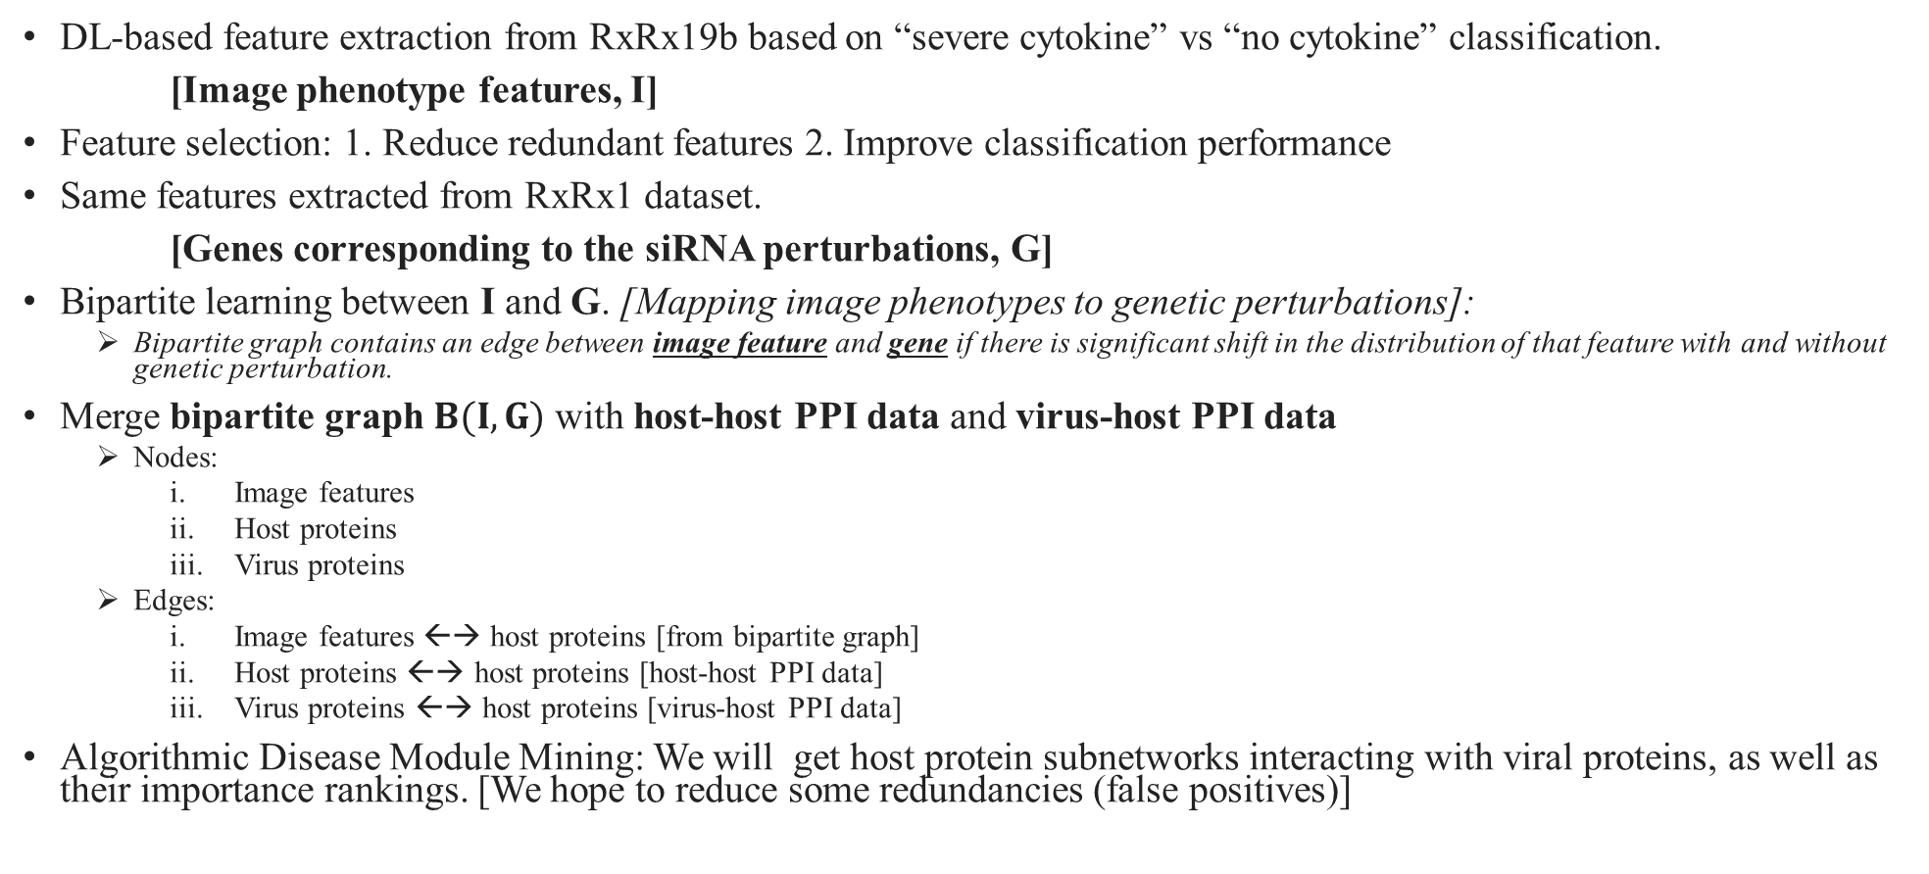
Methodology:
DL-based feature extraction from RxRx19b based on “severe cytokine” vs “no cytokine” classification.
[Image phenotype features, I]
Feature selection: 1. Reduce redundant features 2. Improve classification performance
Same features extracted from RxRx1 dataset.
[Genes corresponding to the siRNA perturbations, G]
Bipartite learning between I and G. [Mapping image phenotypes to genetic perturbations]:
Bipartite graph contains an edge between image feature and gene if there is significant shift in the distribution of that feature with and without genetic perturbation.
Merge bipartite graph $B(I,G)$ with host-host PPI data and virus-host PPI data
Nodes:
Image features
Host proteins
Virus proteins
Edges:
Image features ←→ host proteins [from bipartite graph]
Host proteins ←→ host proteins [host-host PPI data]
Virus proteins ←→ host proteins [virus-host PPI data]
Algorithmic Disease Module Mining: We will get host protein subnetworks interacting with viral proteins, as well as their importance rankings. [We hope to reduce some redundancies (false positives)]

Slide 9
Methodology (contd…):
DL-based feature extraction from RxRx19b based on “severe cytokine” vs “no cytokine” classification.
[Image phenotype features, I]
Feature selection: 1. Reduce redundant features 2. Improve classification performance
Same features extracted from RxRx1 dataset.
[Genes corresponding to the siRNA perturbations, G]
Bipartite learning between I and G. [Mapping image phenotypes to genetic perturbations]:
Bipartite graph contains an edge between image feature and gene if there is significant shift in the distribution of that feature with and without genetic perturbation.
Merge bipartite graph B(I,G) with host-host PPI data and virus-host PPI data
Nodes:
Image features
Host proteins
Virus proteins
Edges:
Image features ←→ host proteins [from bipartite graph]
Host proteins ←→ host proteins [host-host PPI data]
Virus proteins ←→ host proteins [virus-host PPI data]
Algorithmic Disease Module Mining: We will get host protein subnetworks interacting with viral proteins, as well as their importance rankings. [We hope to reduce some redundancies (false positives)]

Slide 10
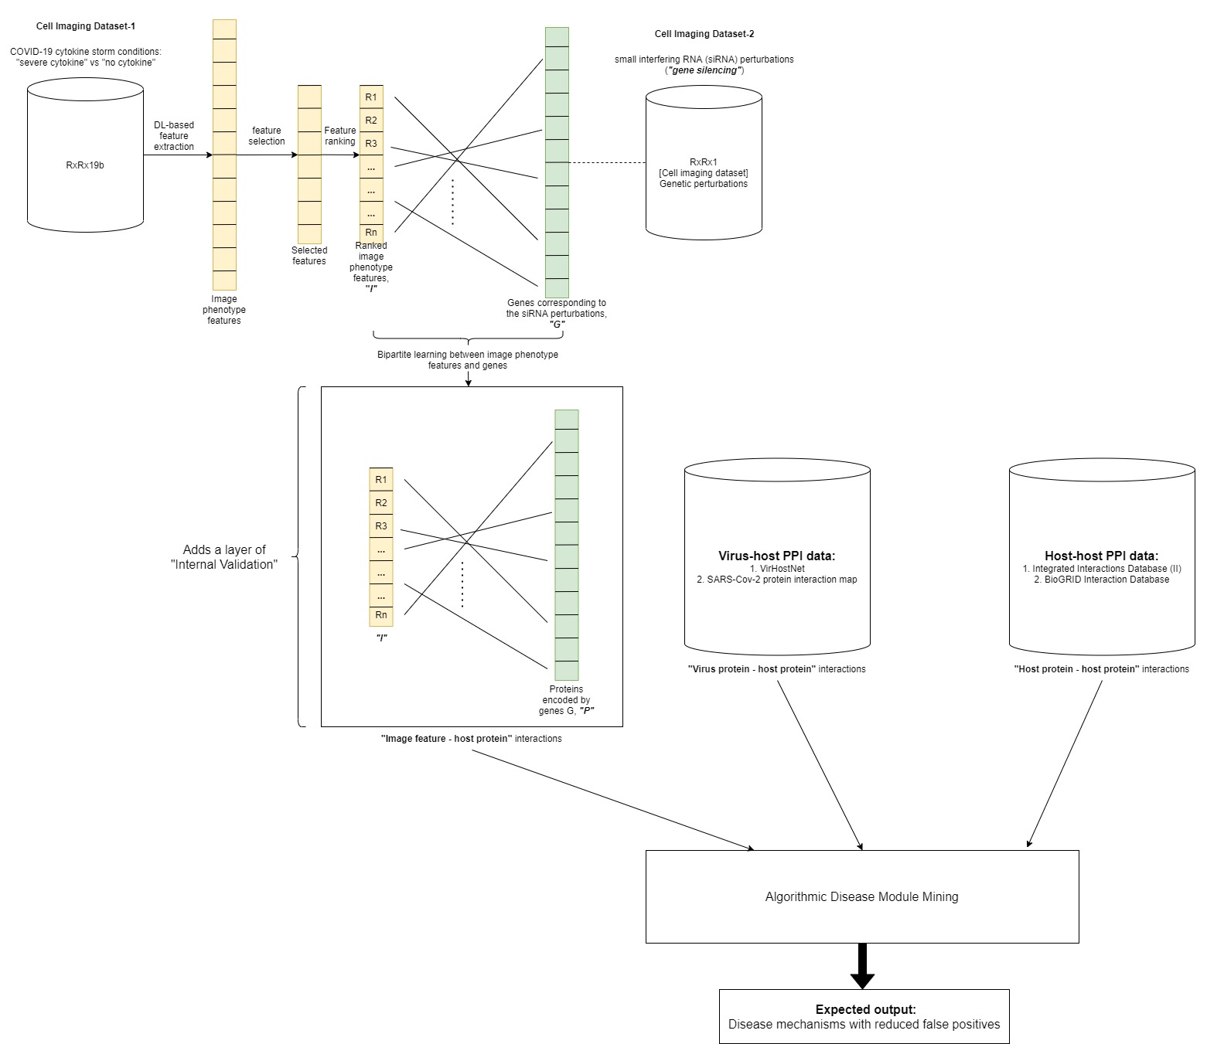
Methodology (contd…):
Fig 1. A schematic representation of the proposed workflow

Slide 11
Task assignment
Divide task into 4 parts

Slide 12
Appendices

Slide 13
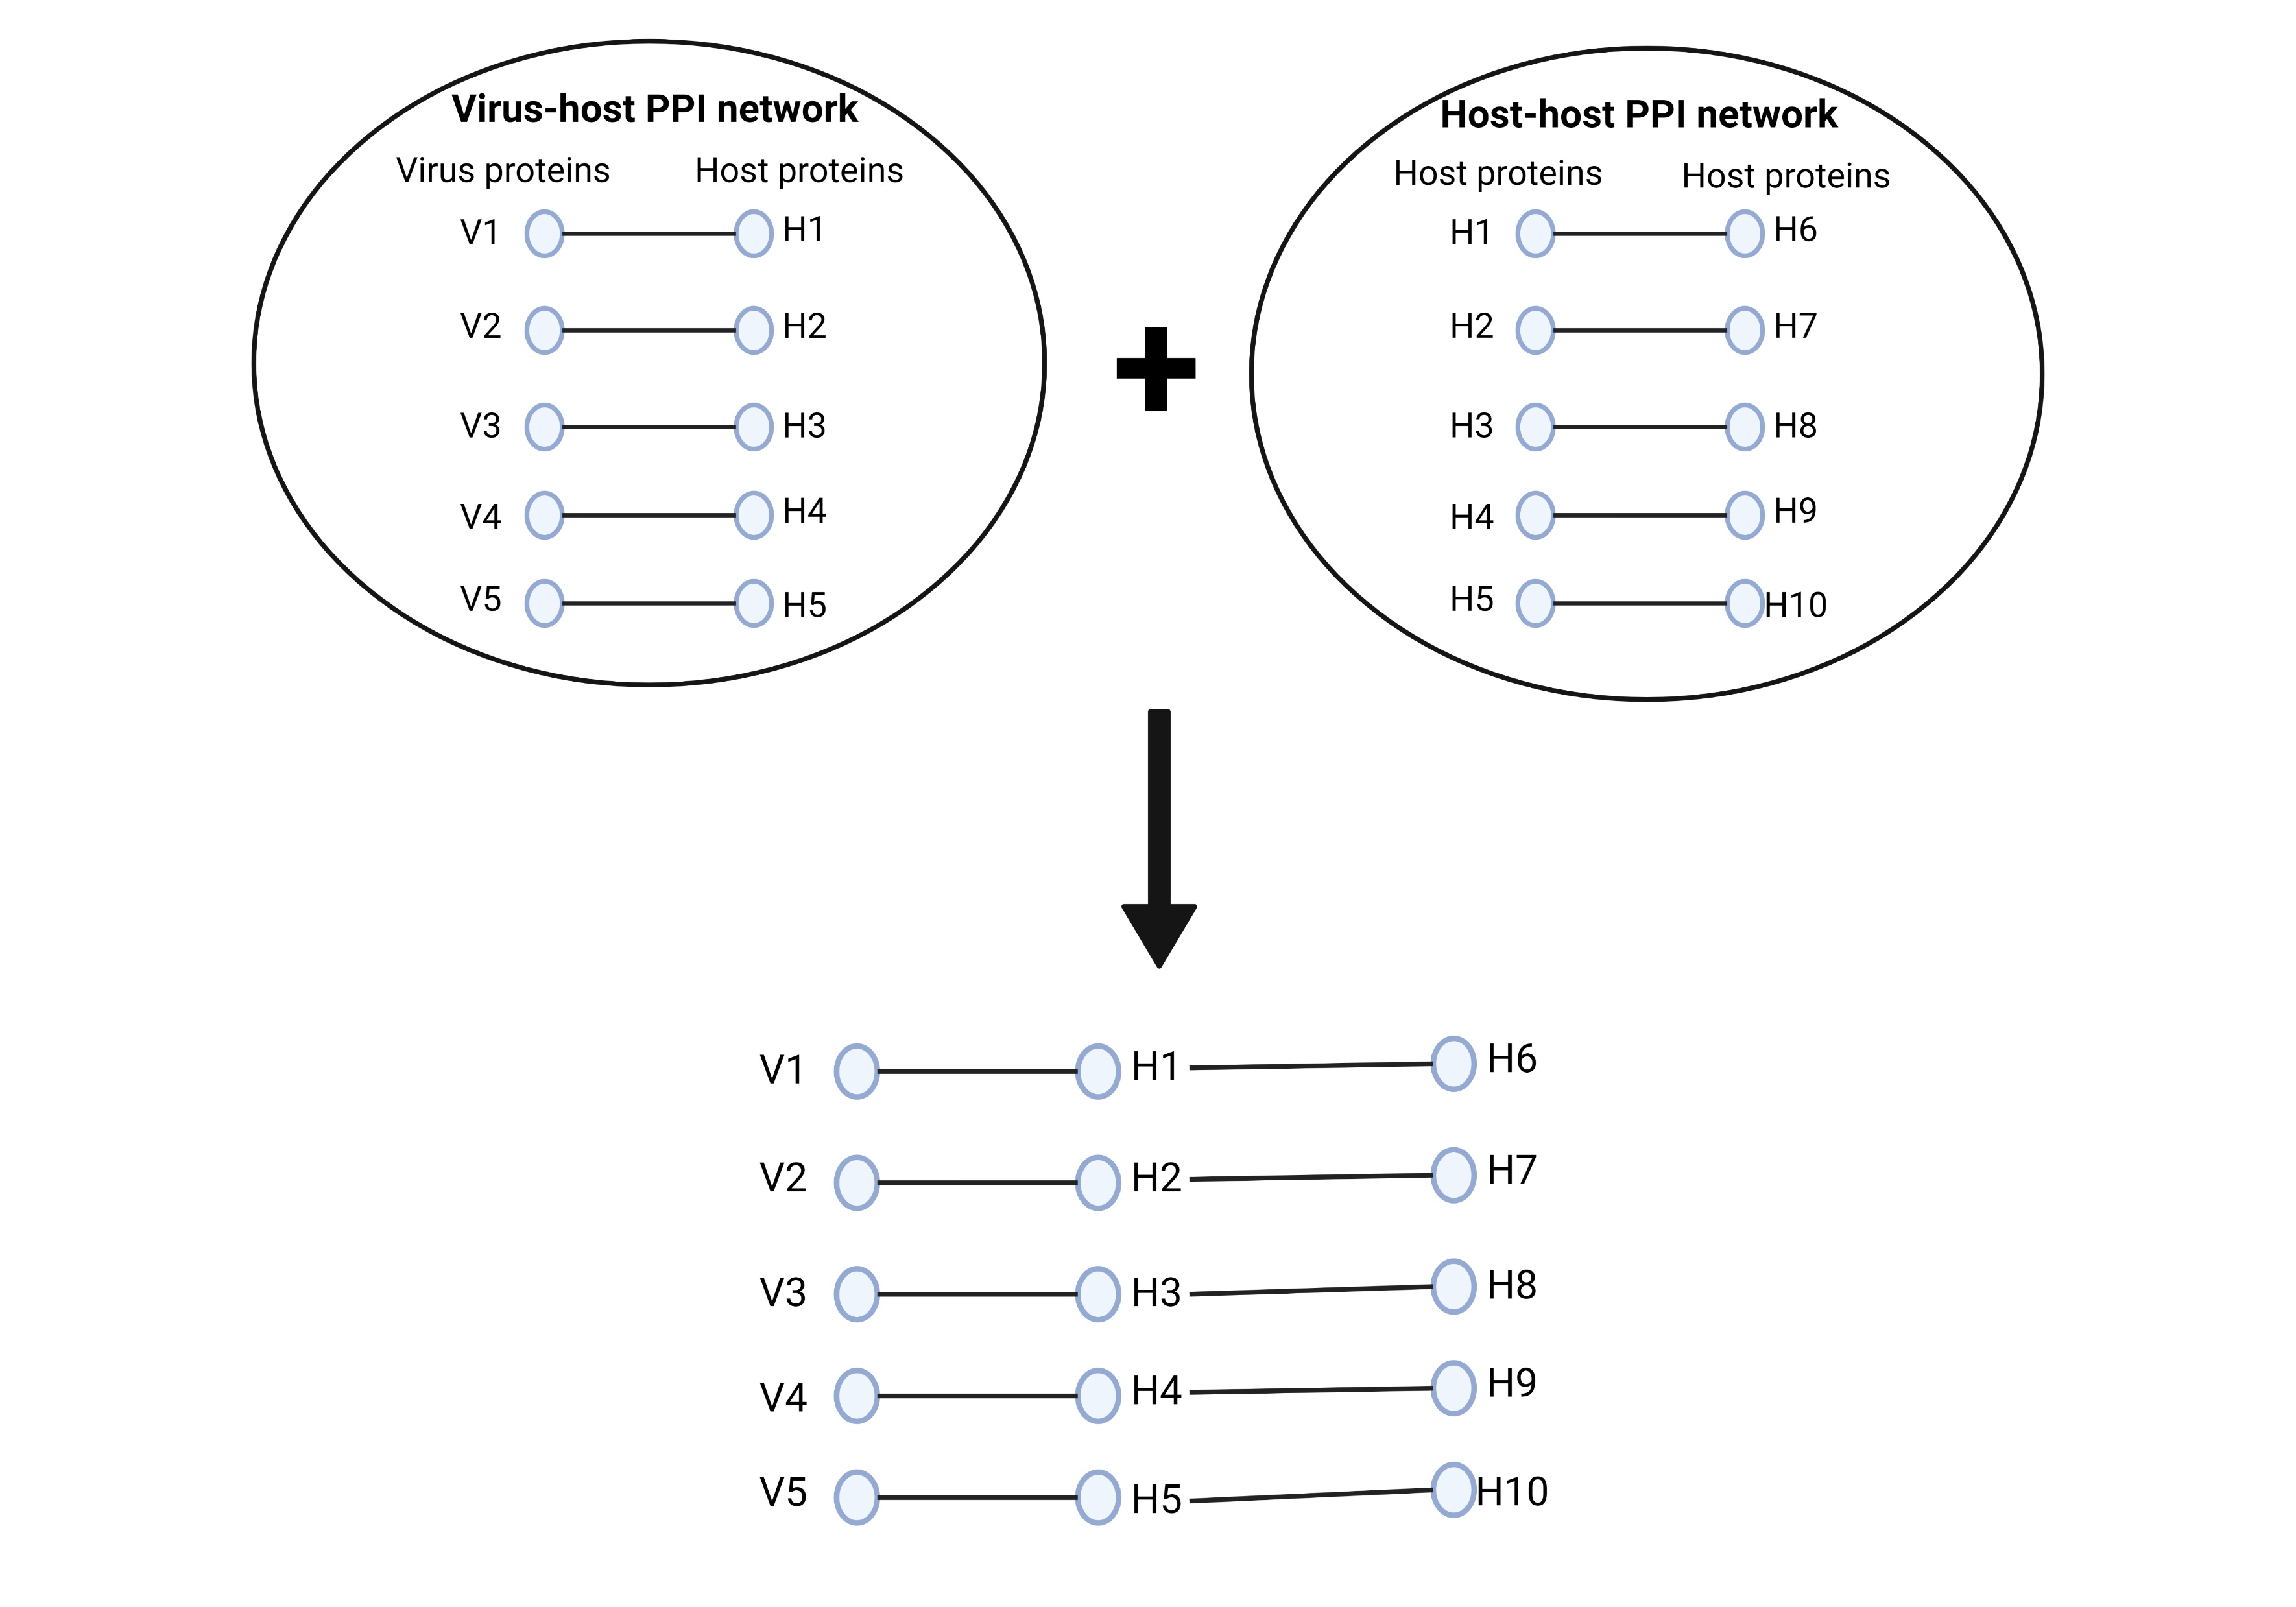
A1: Combining Host-Host and Virus-Host PPI Networks

Slide 14
PPI networks
./PPI_NETWORKS/
Virus-host PPI networks: Not sure what those two networks are, please check.
Also, find other suitable virus-host PPI network from one of the following links:
https://www.google.com/search?q=HEK293T_SARS-CoV-2+ppi+network&oq=HEK293T_SARS-CoV-2+ppi+network&aqs=chrome..69i57.5470j0j7&sourceid=chrome&ie=UTF-8
https://www.frontiersin.org/articles/10.3389/fsysb.2022.815237/full (http://severus.dbmi.pitt.edu/corona/)
https://www.ncbi.nlm.nih.gov/pmc/articles/PMC7425553/
https://www.google.com/search?q=sars+cov+2+human+protein+interaction+networks&oq=sars+cov+2+human+protein+interaction+networks&aqs=chrome..69i57j0i22i30.7719j0j7&sourceid=chrome&ie=UTF-8
https://pubmed.ncbi.nlm.nih.gov/32838020/
https://www.ncbi.nlm.nih.gov/pmc/articles/PMC7239059/
Or do some more searches on Scholar if you still haven’t found any relevant ones.

Slide 15
Disease Module Mining Algorithm
Try PCST (python package pcst_fast)
Try others (ROBUST, DIAMOND, DOMINO etc)

Slide 16
Convert 6-channel cell painting image to RGB

Slide 17
Thank you!

